Slide 1
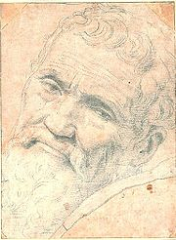
Michelangelo
(1475 – 1564)
Focused on art and sculptures
Practiced new techniques and produced great works of art
The 18 – foot statue of David is greatly admired for its form
Painted the ceiling of the Sistine Chapel in Rome between 1508 and 1512

Slide 2
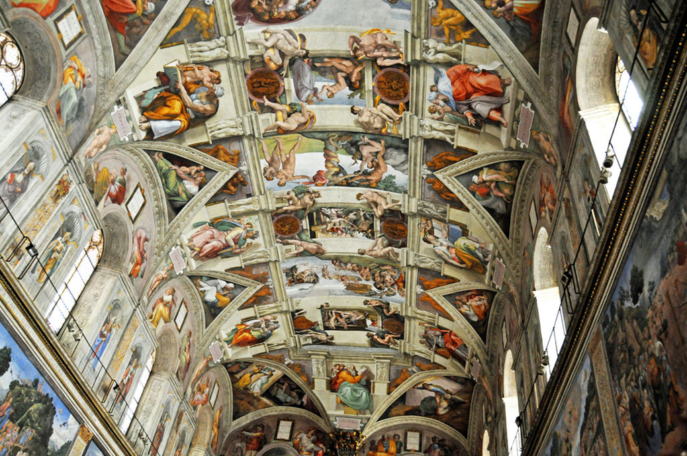

Slide 3
Christian Humanists
Called for the reform of Christianity as a whole
Believed humans could improve themselves and the world around them through their power of reason
Believed the Catholic Church had distorted religion for their own purposes
Believed through education a person could reach inner piety
Most noted Christian Humanists were Desiderius Erasmus and Thomas More

Slide 4
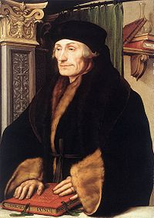
Desiderius Erasmus
Believed Christianity should be the guiding philosophy
Believed inner piety was the pinnacle of religion
Criticized church leaders
Published a Greek and Latin edition of the Bible in 1516

Slide 5
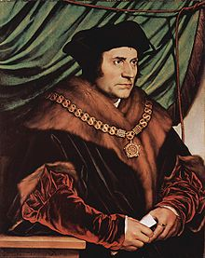
Thomas More
Believed education was the path to piety
In 1516 published “Utopia” describing a society based on cooperation and reason
Pursued a lifetime career in government
Refused to support Henry VIII’s authority over the church and the Pope in England

Slide 6
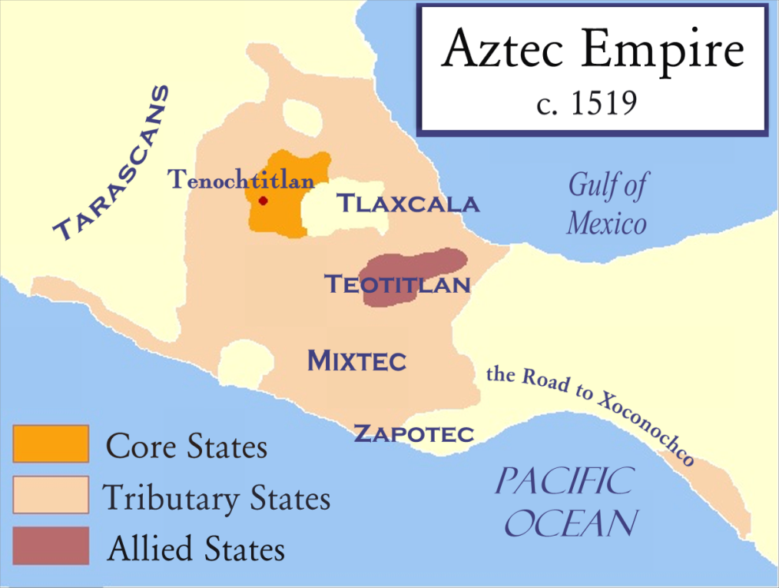
Rise of the Aztecs
Established in the Valley of Mexico around 1300
Controlled much of Mesoamerica from the 14th – 16th centuries
Reached its apex in 1519 with a population of about 11 million
Practiced human sacrifice

Slide 7
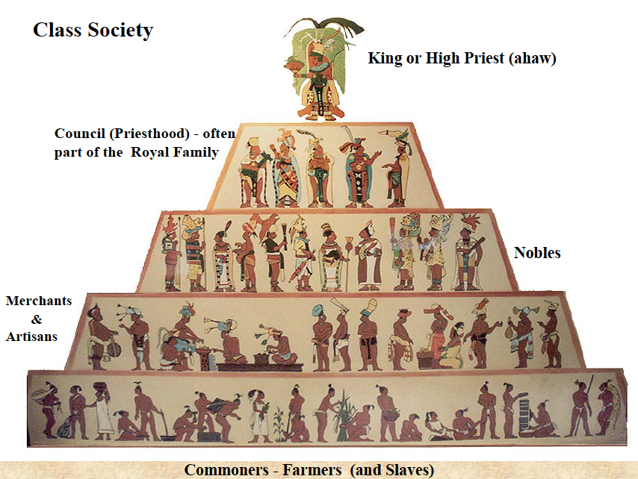
Aztec Society
Highly structured and hereditary
Elite lived close to the city center
Priests were among the elite class
No large merchant class
Peasants and slaves supplied food stuffs and labor for public works

Slide 8
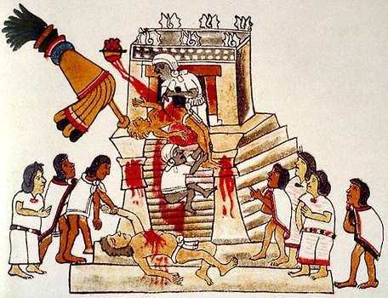
Aztec Empire
An alliance and tributary form of government
Traded throughout the region
Developed a local and regional market system
Practiced polytheism
Human sacrifice was part of religious rituals

Slide 9
Rule of the Empire
City-states ally or pay tribute to the ruler in Tenochtitlan, the capital
Ruler had to be of royal family lineage
Local rulers remained in power as long as they supported the Aztec ruler
Military campaigns maintained control and expanded the empire
Required labor services from all captured or conquered peoples

Slide 10
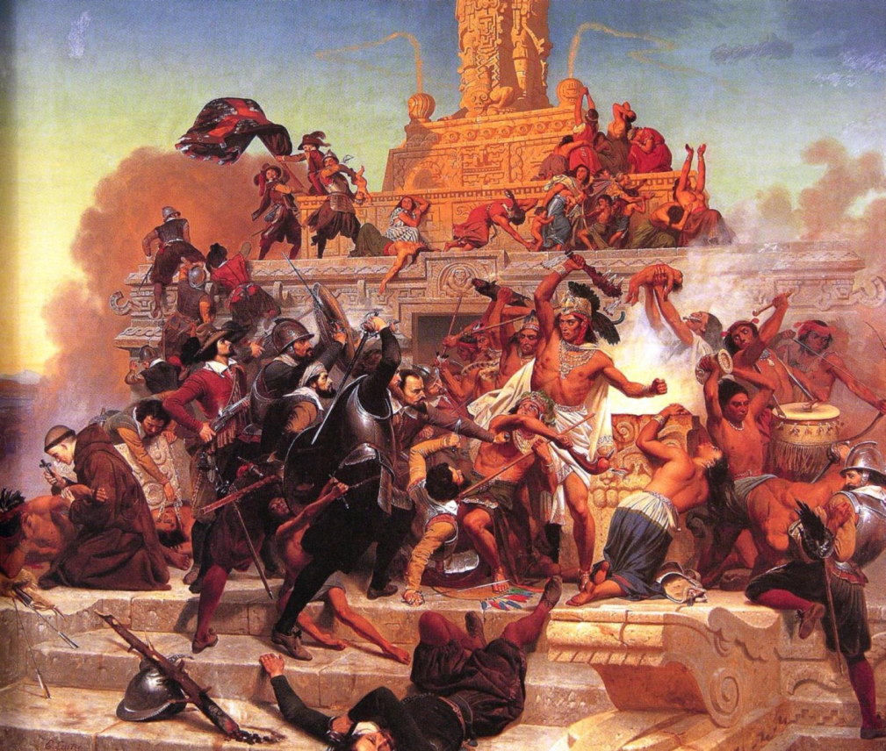
Fall of the Aztec
Spanish under Hernan Cortes encounter the Aztec in central Mexico in November 1519
Aztec king, Montezuma, is taken hostage and killed
The Aztec were weak due to war with the Spanish and a smallpox epidemic
In August 1521, Cortes captured the Aztec capital, Tenochtitlan

Slide 11
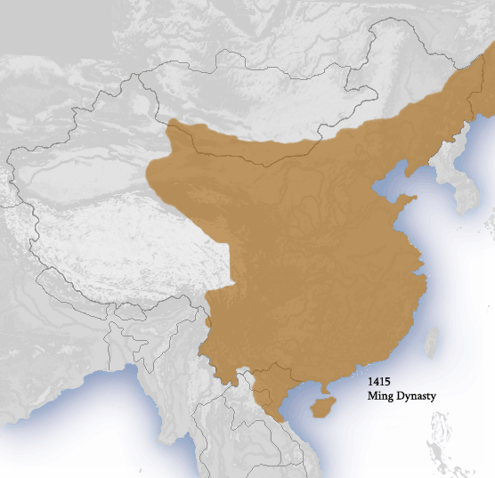
Rise of the Ming
Established by Zhu Yuanzhang in 1368
Established capital at Nanjing
Created a centralized bureaucratic government
Expanded agriculture and the economy
Expanded their power and influence by sending fleets into the Indian Ocean

Slide 12
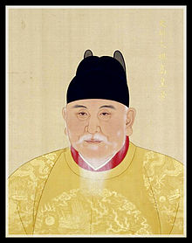
Zhu Yuanzhang
Proclaimed himself Hongwu Emperor of the Ming in January 1368
Outlawed anything Mongol
Replaced all Mongol officials with Han officials
Reinstituted the civil service examination system

Slide 13
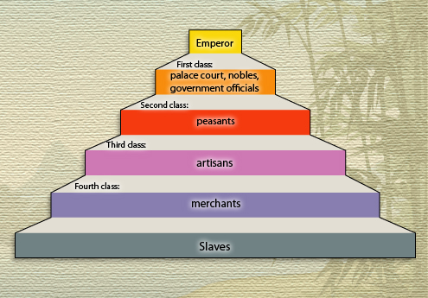
Ming Society
Highly structured and hereditary four class system
Revival of Confucianism
Class mobility was reduced
Rituals provided cohesion
Role of women became more controlled

Slide 14
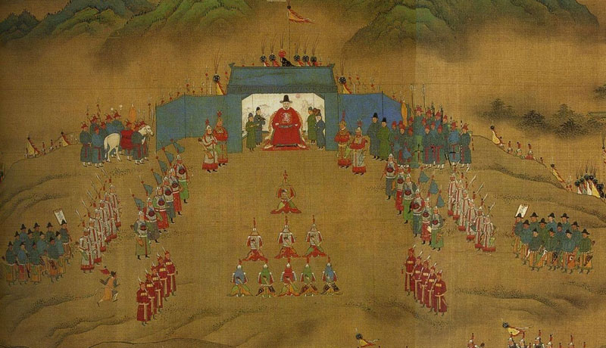
Ming Government
Emperor was head of the government
Office of Grand Secretariat controlled the Six Ministries
Officials delegated to oversee the thirteen provinces
Expanded the civil examination system

Slide 15
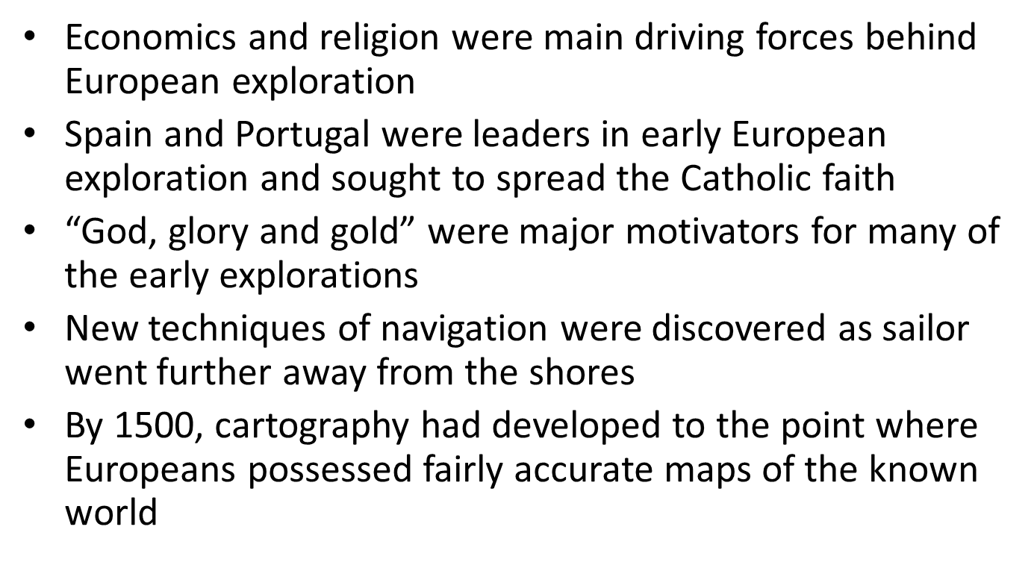
European Exploration

Slide 16
European / Chinese Exploration
Between 1405 – 1433, the Ming government launched seven expeditions into the Indian Ocean basin to expand its influence
By 1450, the Chinese fleet lay at anchor falling into disrepair
On May 18, 1498, the Portuguese fleet of Vasco de Gama reached the port of Calicut on the western coast of India
Europeans sought wealth and colonies while the Chinese expeditions were diplomatic in nature

Slide 17
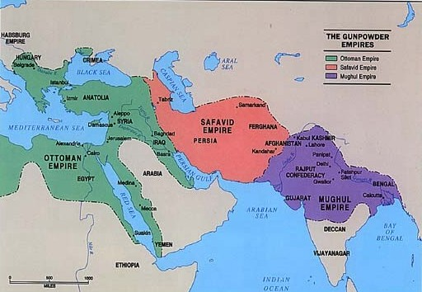
Empires of the Middle East
The Ottoman and Safavid Empires were key in the establishment of Islam in North Africa and the Middle East
Practiced different versions of Islam
Established political, religious, and cultural unity
Often at war over territory and religion

Slide 18
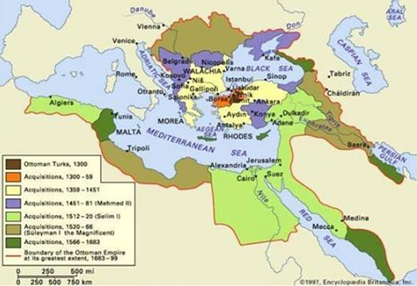
Rise of the Ottomans
Established as an Islamic state by Osman I in 1299 in northwestern Anatolia
Expanded over the next 300 years
Population of 30 million by 1600
Became the leader of the Islamic world

Slide 19
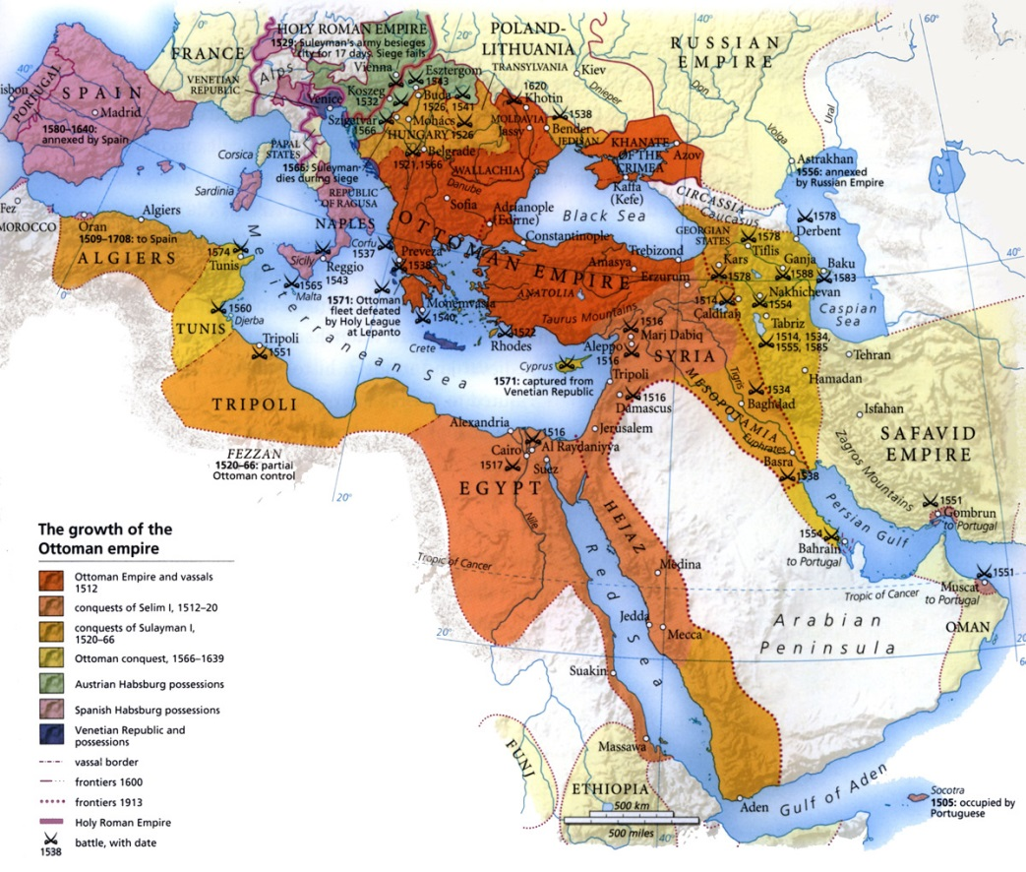
Ottoman Society
Practiced toleration of other religions
Religious officials, the Ulama, controlled the religious teachings and judicial system
Viewed themselves as the “Protectors of Islam”
Largely divided along ethnic and religious lines

Slide 20
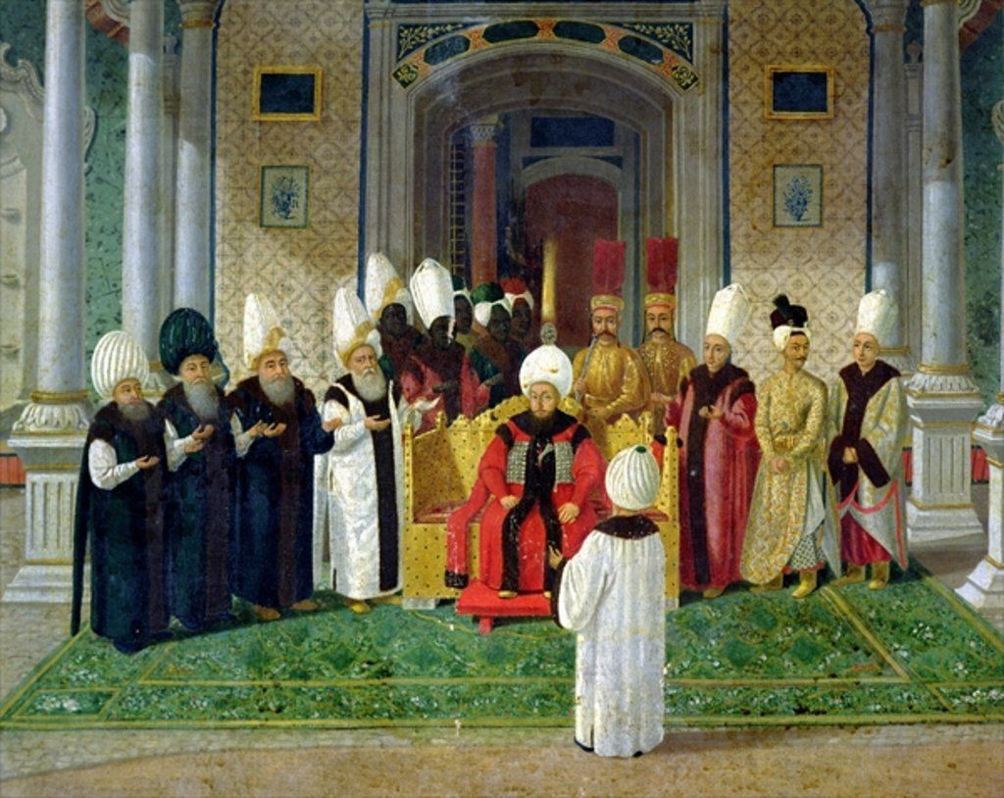
Ottoman Government
Sultans were the supreme political and military leaders of the empire
Advisors and ministers oversaw government functions
Authority was delegated to local governors
Brought political unity to the region

Slide 21
Ottoman Empire
Became a major military and political power in the Mediterranean region
Captured Constantinople in 1453 ending the Christian Byzantine Empire
Conquered the Balkans by 1500
By 1600 had expanded across the Middle East, North Africa and southeastern Europe
Reached its apex in 1683 during the Siege of Vienna

Slide 22
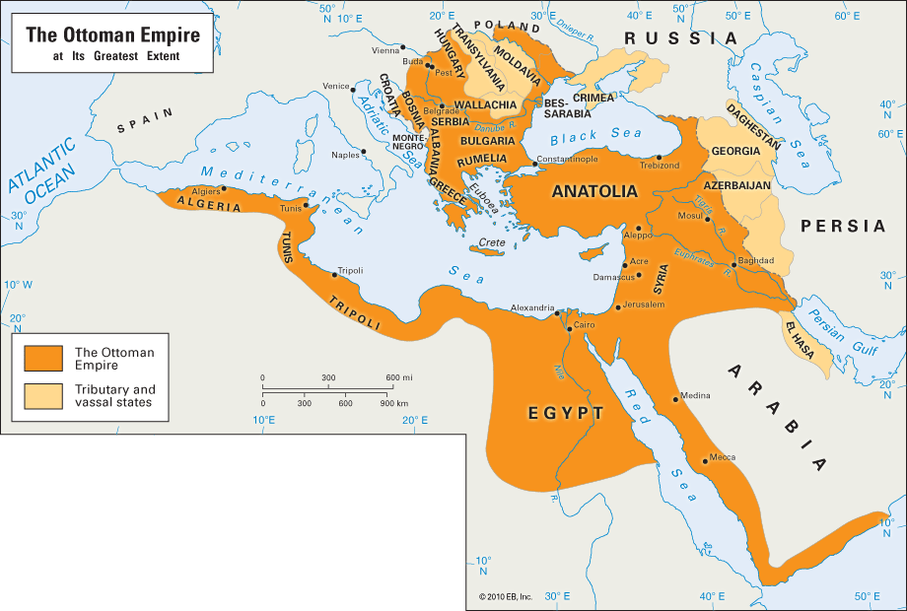
Decline of the Ottomans
By 1750 Ottoman power and influence began to wane
Badly defeated by Russia in 1768 – 1774
Nationalists movements spread throughout the empire in the early 1800s
Weak rulers, wars, a failing economy, taxes and foreign expansion led to its dissolution in 1922

Slide 23
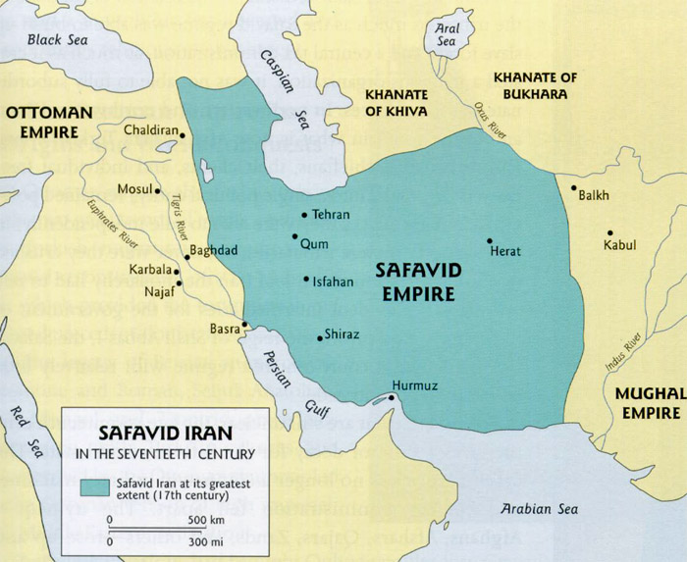
Rise of the Safavids
Established as a Shia Islamic state by Shah Ismail I in 1501 on the Iranian Plateau
Continuous wars with the Ottomans
Established relations with European states
Reached its peak by 1600

Slide 24
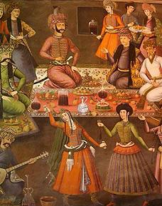
Safavid Government
Shah was absolute ruler
Royal court made up of elites
Complex bureaucracy to prevent corruption
Local governors controlled “public” lands
Gained great wealth due to trade routes

Slide 25
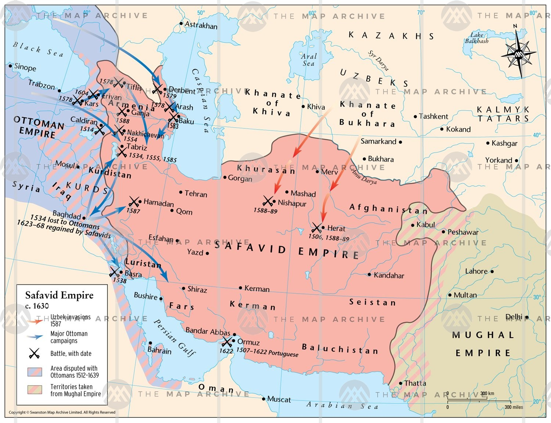
Decline of the Safavid
By 1700 Shahs had become complacent
Government became more corrupt
Military became less effective
Division of powers between the Shahs and the Ulama
Defeated by Afghan army in 1722

Slide 26


Empires of Africa and India
The Songhai spread their influence in West Africa by controlling key trade routes
The Mughal spread their influence on the Indian peninsula and controlled key trade routes
The Hindu Mughal Empire ruled over non-Hindu peoples and established inclusive programs for them

Slide 27
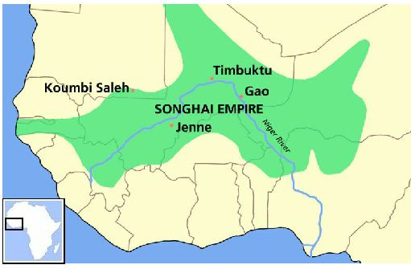
Rise of the Songhai
Established by Sunni Ali in 1464 in western Africa with its capital at Gao
Centered along the Niger River
Expanded into a major trade network
Received tribute from surrounding chiefdoms
Reached its peak by 1549

Slide 28
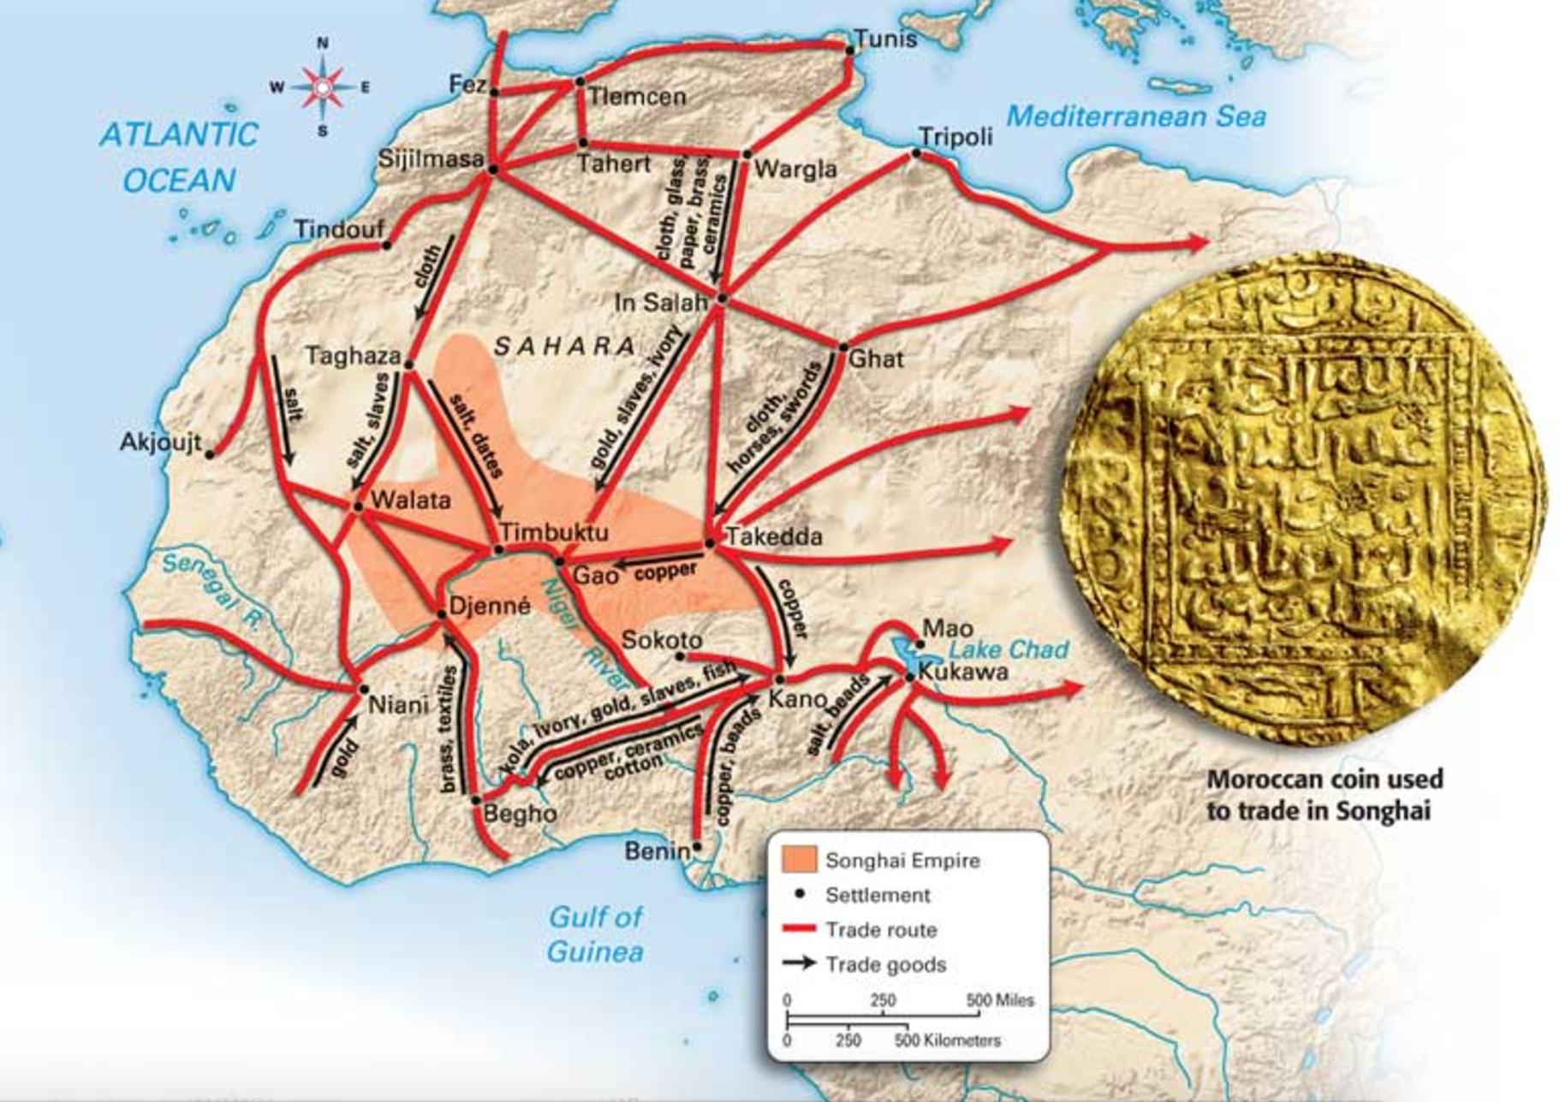
Songhai Empire
King was absolute ruler
Empire was divided in to five provinces
Ministers oversaw government functions
Became an Islamic state in 1493
Gained wealth due to control of major trade routes and ports

Slide 29
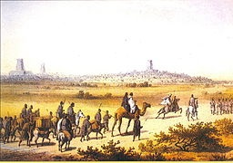
Decline of the Songhai Empire
Caste system based society
Outdated military
Revolt in 1528 led to a succession of weak kings
Continued attacks by the Moroccans in the north

Slide 30
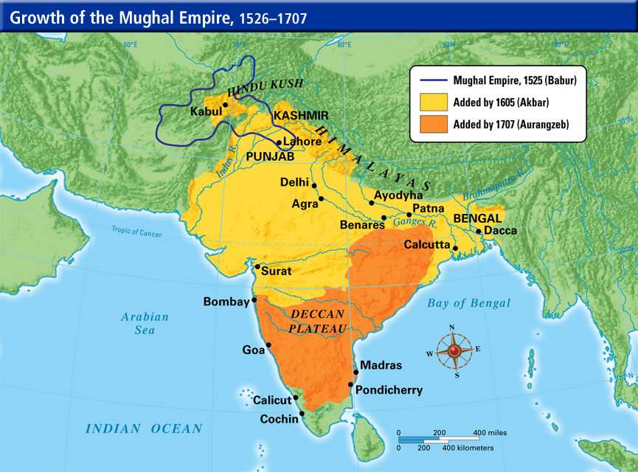
Rise of the Mughal
Established by Babur as an Islamic state in 1526
80% of the population practiced Hinduism
Practiced toleration of others under Akbar (1556 – 1605)
Strict adherence to Muslim law under Aurangzeb (1658 – 1707)

Slide 31
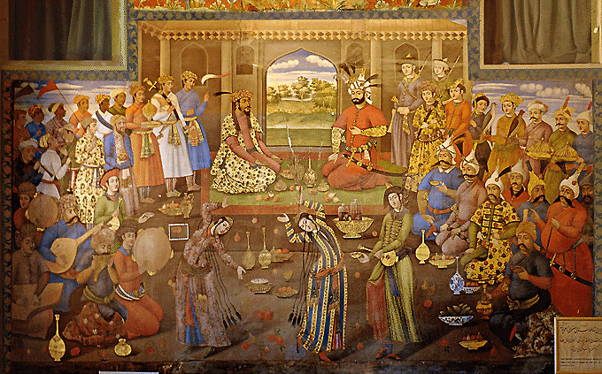
Mughal Empire
Campaigns of expansion began in 1556
Expanded trade with European states
Developed a loyal military aristocracy
Developed a stable and strong economy
Practice religious tolerance

Slide 32
Decline of the Mughal Empire
The death of Aurangzeb in 1707 led to a succession of weak rulers
Strict religious policies of Aurangzeb led to revolts
Local rulers expand their power and influence
Rise of the Maratha Empire
British East India Company deposed the last emperor in 1857

Slide 33
Connecting the World
Expanding trade routes allowed for expanded commerce
Trade routes also allowed for the exchange of knowledge and cultural and religious ideas
Each region contributed to the exchange
European exploration played a major role in connecting the various regions
Beginning of the global market

